Slide 1

SMART HOME ENTRY SYSTEM
Course Project on Smart System Design
Submitted by
S. Shiva keerthi (19K41A05B1)
P. Rithika Reddy (19K41A05A8)
P. Vamshi Krishna (19K41A05A7)
N. Sai Charan (19K41A05A6)
Under the guidance of
Mr. Ch. Rajendra Prasad,
Assistant Professor, Dept. of ECE

Slide 2
Introduction
Existing system
We have a lock and key system to enter the house. Also, we have a non-automated home. We have to switch on the appliances manually.
It has less security. In addition to this, the power consumption is a bit more because sometimes we switch on the appliances unnecessarily.
Proposed system
So, to overcome the above mentioned problems we have designed a password based security system to enter the house.
In order to reduce the power consumption we have introduced an automated home where the sensors detect the presence of person and switch on the led and fan.

Slide 3
Objective of the project
The main objective of this project is to provide a digital door lock system for a home.
In the present scenario, many people are preferring automated system over the non - automated ones.
In this project we use a password as lock so that only the owner of the house knows the password.
This type of home automation system will save our money, provide security to the house and reduces consumption of electricity.

Slide 4
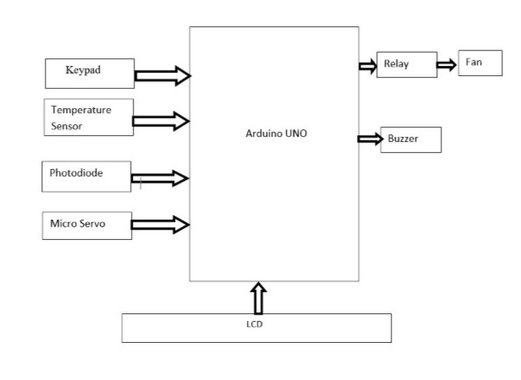
Block diagram

Slide 5
Working
In this project we used Keypad through which we can open the door if we give the correct password.
After giving the correct password the PIR Sensor detects the person and switches on the LED based on the brightness in the room.
Brightness in the room is detected by the Photodiode.
The temperature will be detected by the temperature sensor.
Also, based on the temperature in the room the fan will be switched on and its speed will be controlled.
If we give the wrong password, then piezo buzzer will alert us.

Slide 6
HARDWARE COMPONENTS
Arduino UNO
Keypad
PIR sensor
Photodiode
TMP36
Relay
Piezzo Buzzer
Micro Servo
DC Motor
Connecting wires

Slide 7
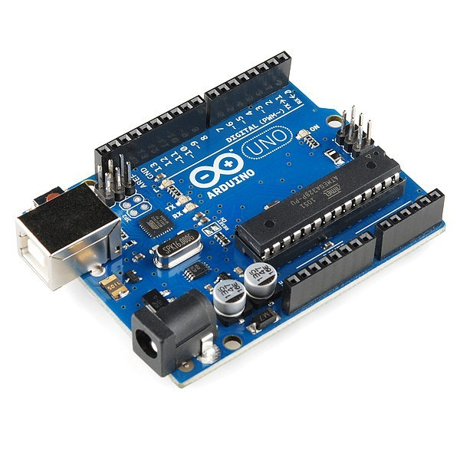
Hardware description
Arduino UNO
Specifications
Arduino uno is an open source micro controller board.
Operating Voltage is 5 Volts
Input Voltage ranges from 7 to 12 Volts
Input Voltage ranges from 6 to 20 Volts
Digital I/O Pins are 14
Analog Input Pins are 6
DC Current per I/O Pin is 20mA
DC Current 3.3V Pin is 50mA
Flash memory: 32KB of which 0.5Kb used by bootloader
The length of this board is 68.6 mm
The width of this board is 53.4 mm
The weight of this board is 25 g

Slide 8
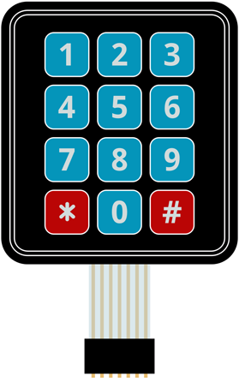
Keypad
Here we are using a keypad to give the password.
We use 3 rows and 3 columns in the keypad.
When we press a key in the keypad Arduino
will detect that key and give input to the program.
Specifications
Maximum Rating: 24 VDC, 30 mA.
Interface: 8-pin access to 4x4 matrix.
Operating temperature: 32 to 122 °F (0 to 50°C)
Dimensions: Keypad, 2.7 x 3.0 in (6.9 x 7.6 cm)

Slide 9
PIR Sensor
It is often referred as PIR, Passive Infrared, Pyroelectric or IR motion sensor
PIRs are usually made of pyroelectric sensor which detect the levels of infrared radiation.
This sensor is used to detect the motion of Humans and animals.
Specifications
Voltage: 5 Volts to 20 Volts
Trigger methods:
L – Disable repeat trigger
H – Enable repeat trigger
Sensing range: <120 degree, within 7 meters
Temperature: -20°C to +80°C

Slide 10
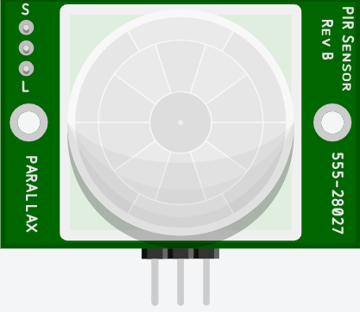
Working of PIR Sensor
A PIR sensor can detect changes in the amount of infrared radiation on it. It varies depending on the temperature and surface characteristics of the objects in front of the sensor.
When an object such as a person,
passes in front of the background,
such as a wall, the temperature at
that point in the sensor's field of view
will rise from room temperature to body
temperature, and then back again.
The sensor converts the resulting change in the incoming infrared radiation into a change in the output voltage and this triggers the detection.

Slide 11
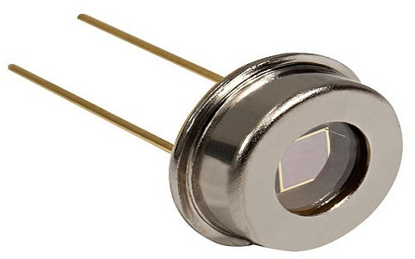
Photodiode
It is light sensor. Light sensors are used to convert light energy into electric energy.
It works on the principle of Photoelectric effect.
Photodiodes may contain optical filters, built-in lenses, and may have large or small surface areas.
We used photodiode to detect the
brightness in the room.
Types of light sensors
Light dependent resistor
Photodiode
Phototransistor

Slide 12
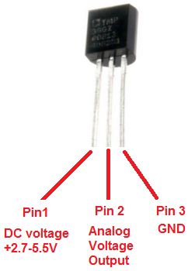
Temperature Sensor
It detects the change in temperature and converts it to electrical signal.
Here we have used a temperature sensor called TMP36 to detect the temperature in the room.
Specifications
Voltage Input: 2.7 V to 5.5 VDC.
±2°C accuracy over temperature
±0.5°C linearity
Operating Range: −40°C to +125°C.

Slide 13
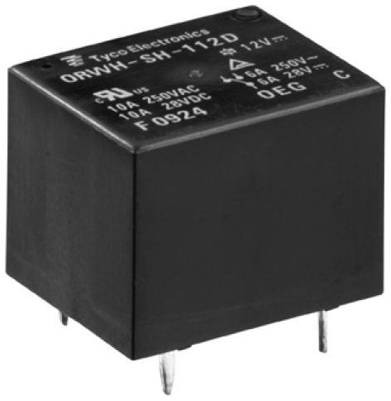
Relay
A relay is an electrically operated switch. It is an electrical actuator.
It is also called as electromagnetic or electromechanical switch. Electromagnet is the heart of a relay.
Relay works on the principle of electromagnetic induction.
Uses of relays
Controls high power circuits using
low input power.
Controls two or more circuits using
single input.

Slide 14
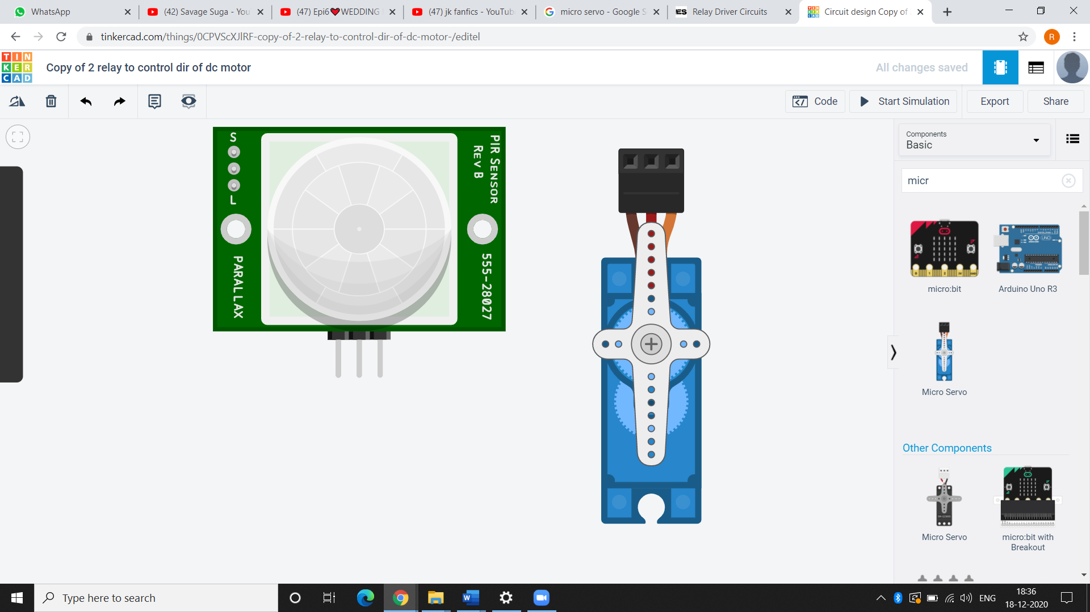
Micro Servo
It is a rotatory actuator.
It allows precise control of angular or linear position, velocity and acceleration. Here, we have used a SG90 micro servo.
Working Principle
Servo motors are controlled by sending an electrical pulse of variable width, or pulse width modulation (PWM), through the control wire.
There is a minimum pulse, a maximum pulse, and a
repetition rate.
A servo motor can usually only turn 90° in either
direction for a total of 180° movement.
Specifications
Operating voltage: 4.8 V (~5V)
Operating speed: 0.1 s/60 degree
Temperature range: 0 ºC – 55 ºC

Slide 15
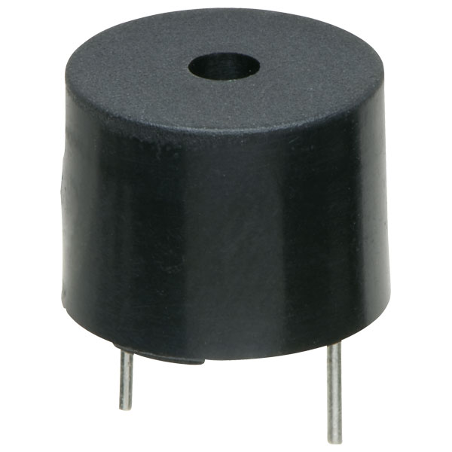
Piezzo Buzzer
It is an audio signalling device.
Here we used it to alert the user whenever he gives a wrong password.
Working Principle
The buzzer contains an outside case with two pins to attach it to power and ground.
When current is applied to the buzzer it
causes ceramic disk to contract or expand.
This causes the surrounding disk to vibrate.
That is the sound we hear.
Specifications
Operating Voltage: 4-8 Volts
Sound type: Continuous Beep
Resonant Frequency: 2300Hz

Slide 16
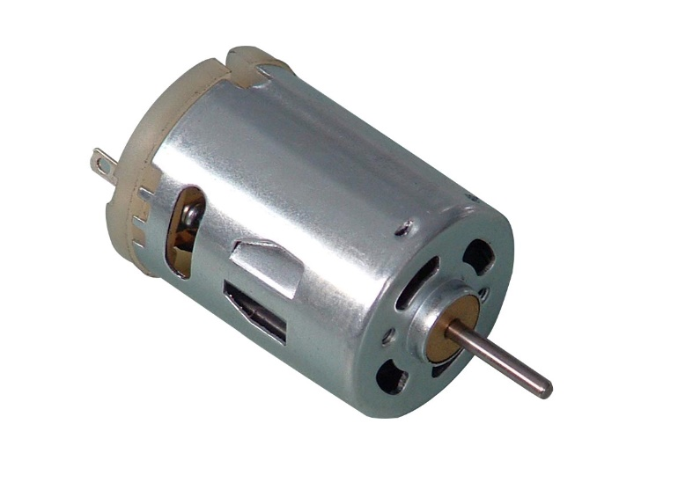
DC Motor
A motor is an electrical machine which converts electrical energy into mechanical energy.
Working Principle
A current-carrying conductor, when kept in a magnetic field, gains torque and develops a tendency to move.
So, when electric fields and magnetic fields interact a mechanical force arises.
Specifications
Operating Voltage: 4.5V to 9V.
Current at No load: 70mA
No-load Speed: 9000 rpm.
Loaded current: 250mA

Slide 17
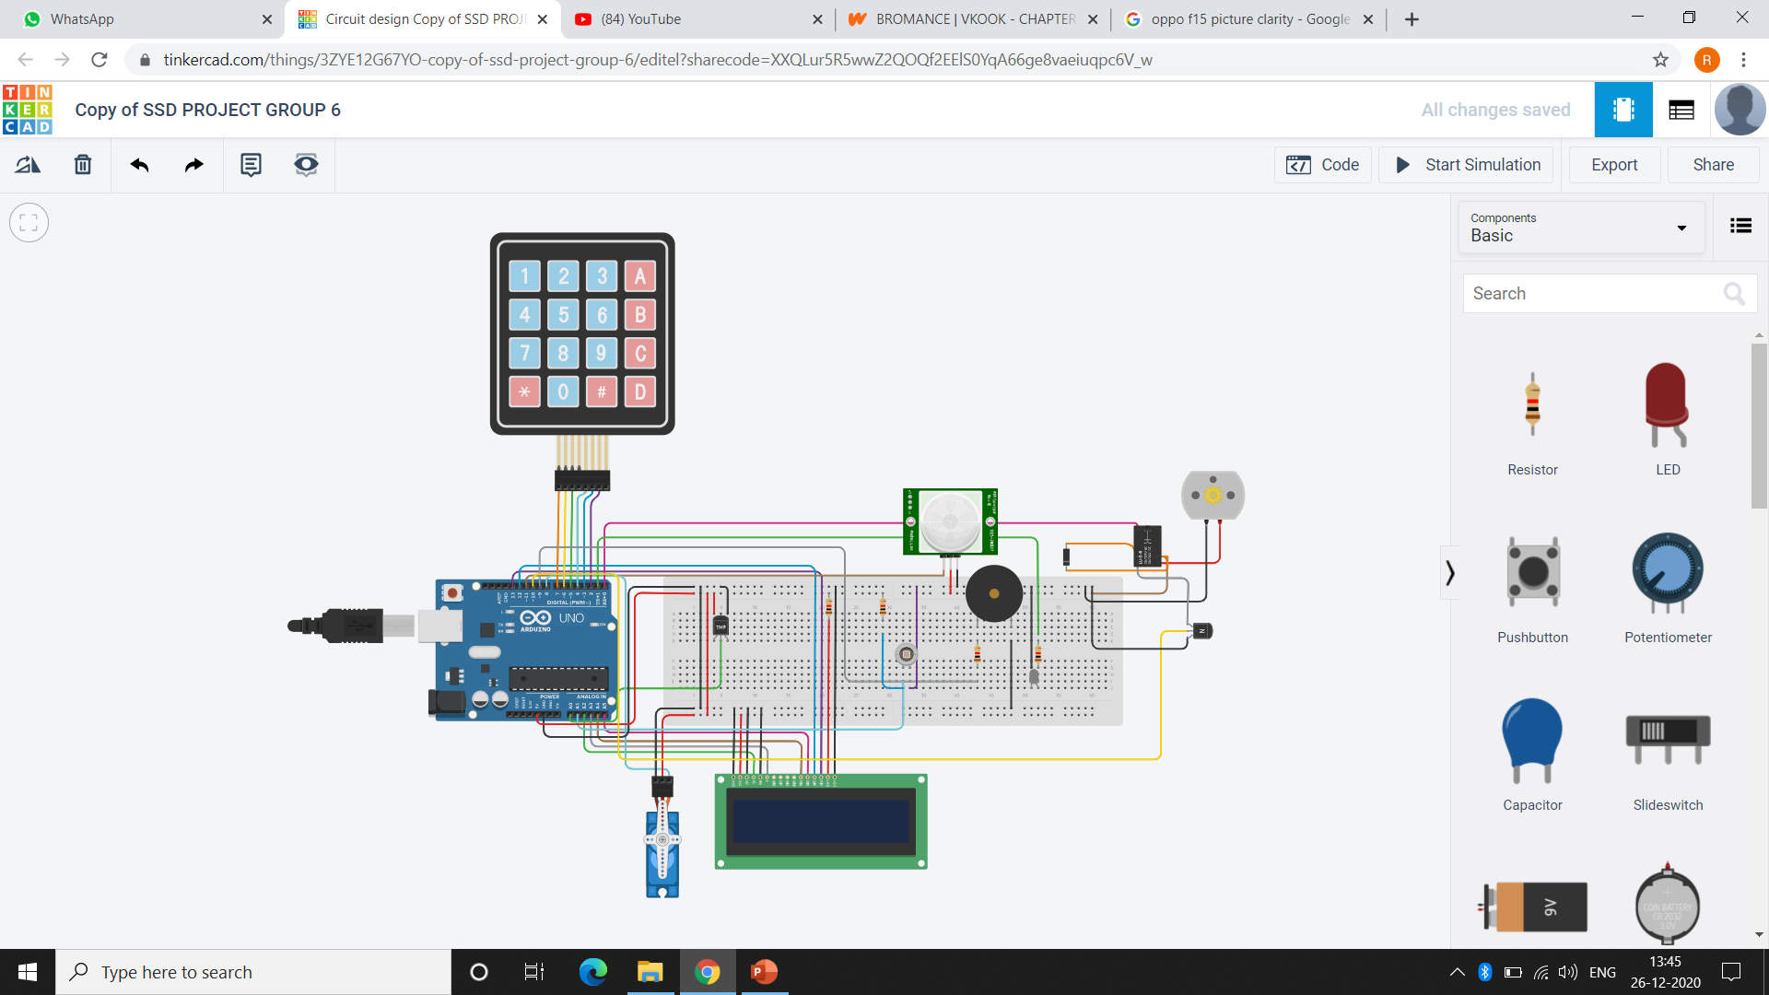
Schematic diagram

Slide 18
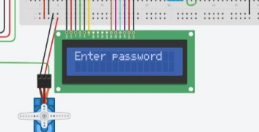
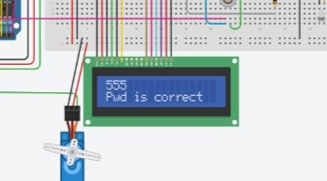
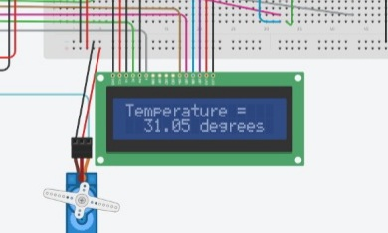
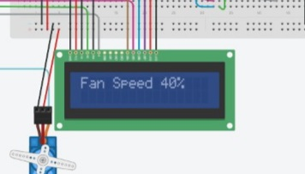
Results
First, it asks the user to enter the password as shown in Fig. 1.1. If the password is correct it prints Pwd is correct as shown in Fig. 1.2.
Fig.1.1 Fig.1.2
The Temperature Sensor detects the temperature and prints it on the LCD screen as shown in Fig.1.3. According to the temperature the fan will be in On Mode and it’ s speed will be displayed on the LCD screen as shown in Fig.1.4.
Fig.1.3 Fig.1.4

Slide 19
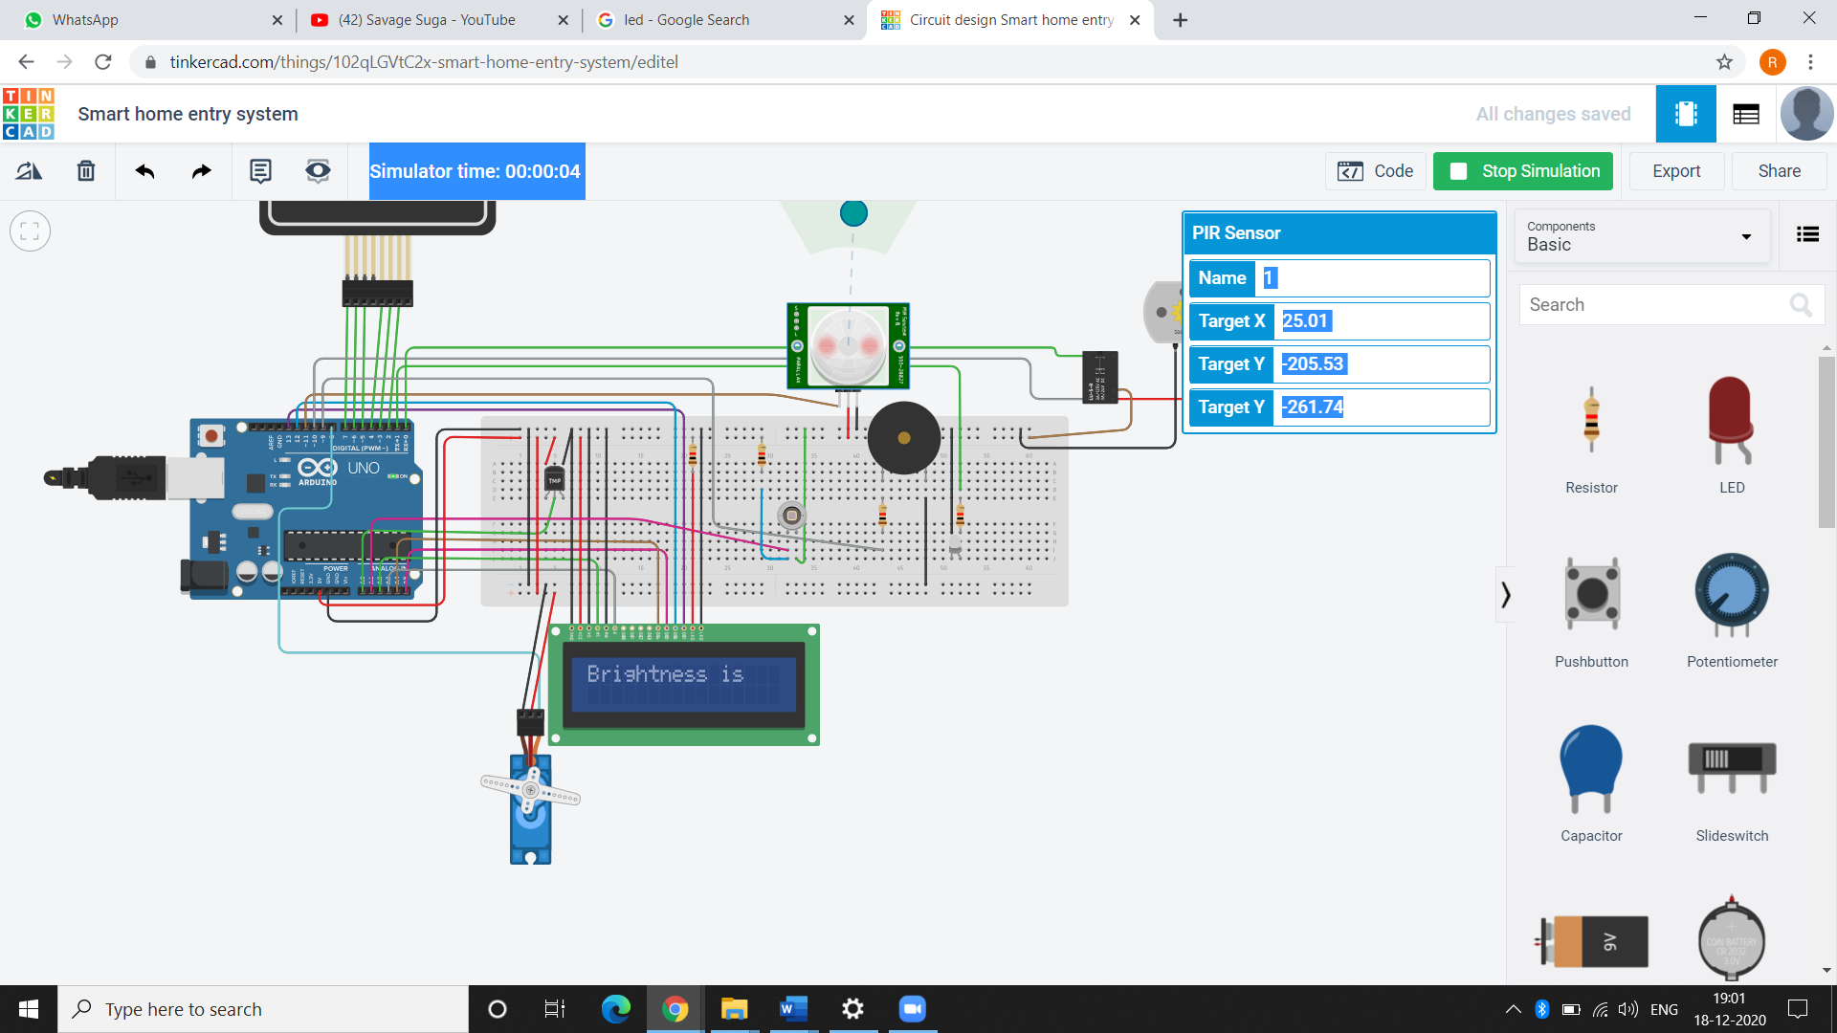
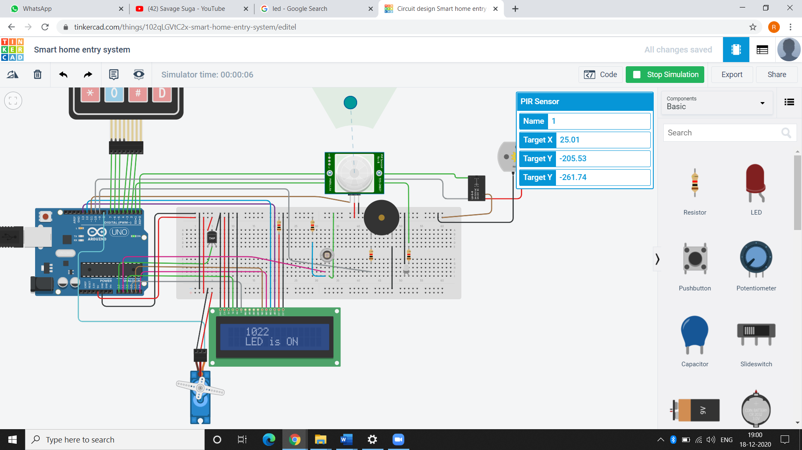
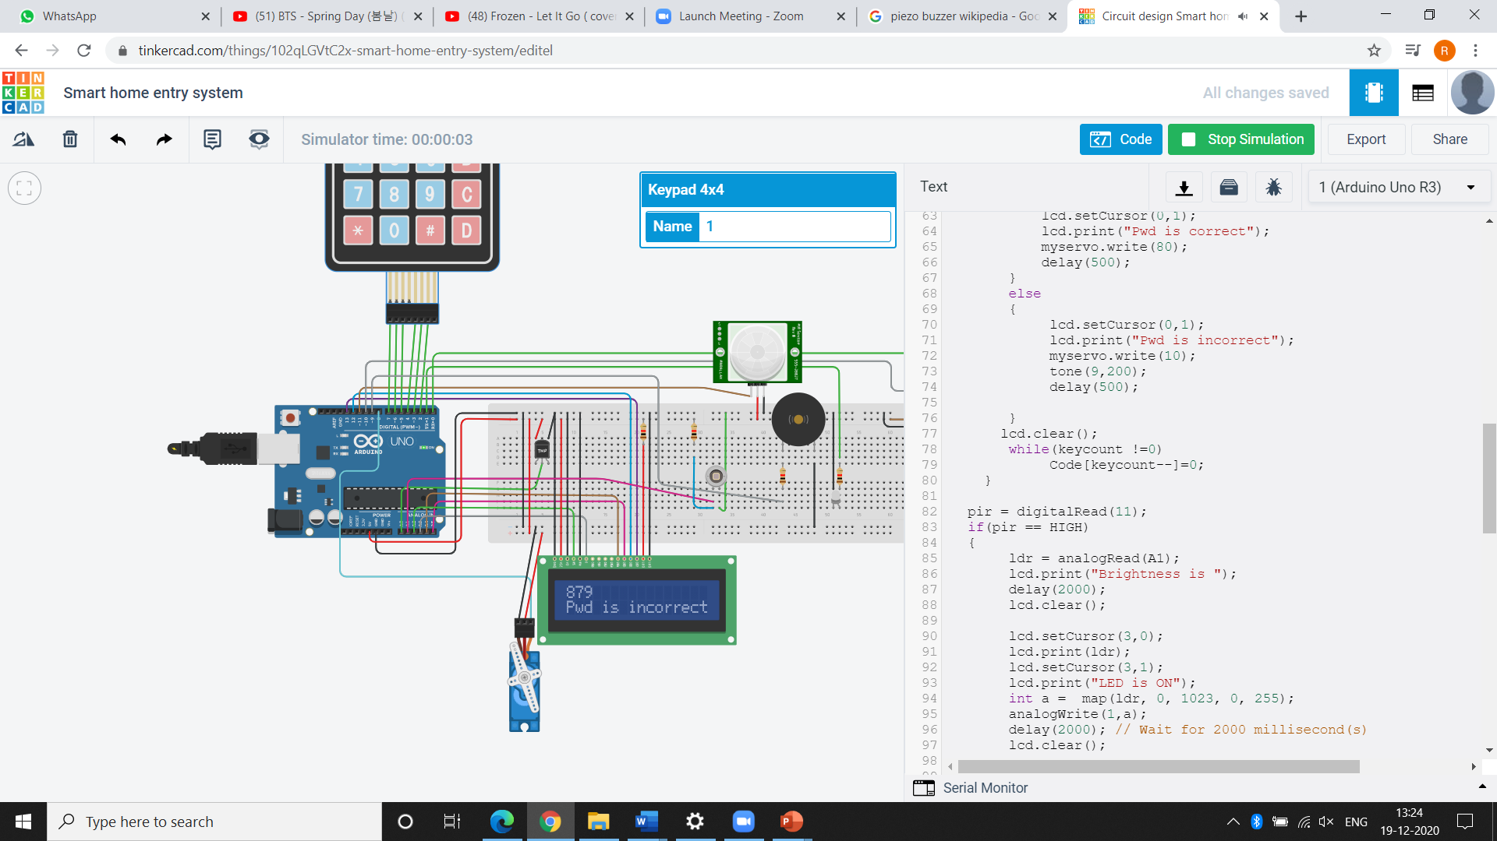
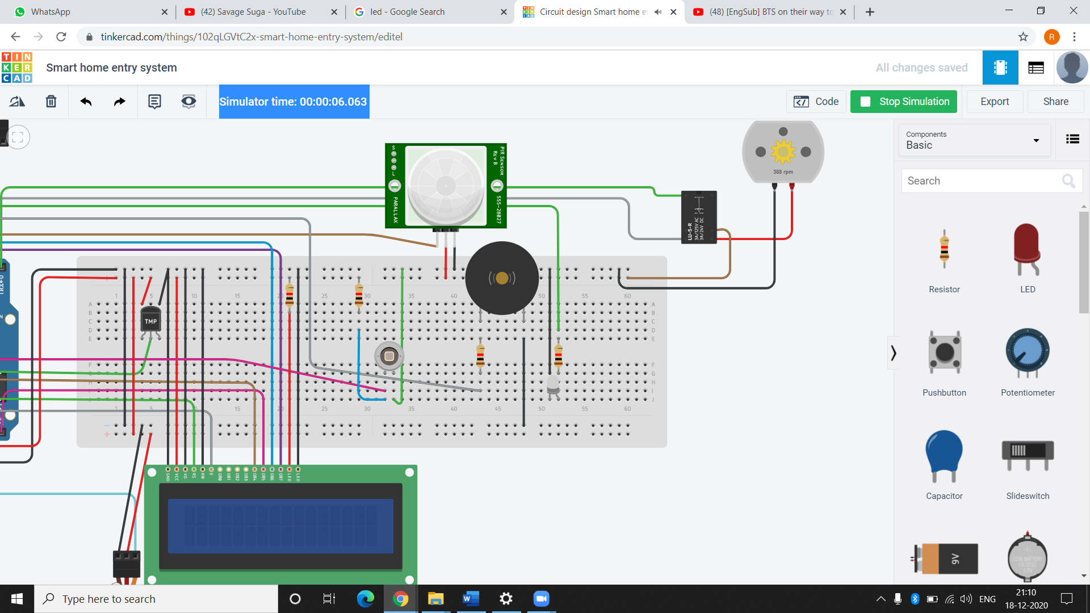
Photodiode detects the brightness in the room and based on that the brightness of led will be controlled as shown in Fig.1.5 and Fig.1.6.
Fig.1.5 Fig.1.6
If the given password is wrong, then it prints that the password is wrong on the LCD screen as shown in Fig.1.7. Also, the piezo buzzer will alert us as shown in Fig.1.8.
Fig.1.7 Fig.1.8

Slide 20
Conclusion
In short, this is a good security system which is based on the password.
Also, the led glows depending upon the brightness in the room and its brightness will be controlled.
In addition to this, the speed of fan depends on the temperature in the room instead of regulating the fan speed manually.
This saves the consumption of electricity and reduces manpower.

Slide 21
We can further try to improve the project in the following ways
We can try to connect this system with an android device to control the appliances with it.
We can extend this automation to other appliances.
Rather than using a Password based security system we can use biometric, iris scanning.
Instead of using piezo buzzer we can use GSM interface which will send SMS if there is any invalid attempt.
We can use gas sensors to detect the fire in case of any emergency.
We can also use a Bluetooth technology to control the appliances.

Slide 22
THANK YOU

